Slide 1
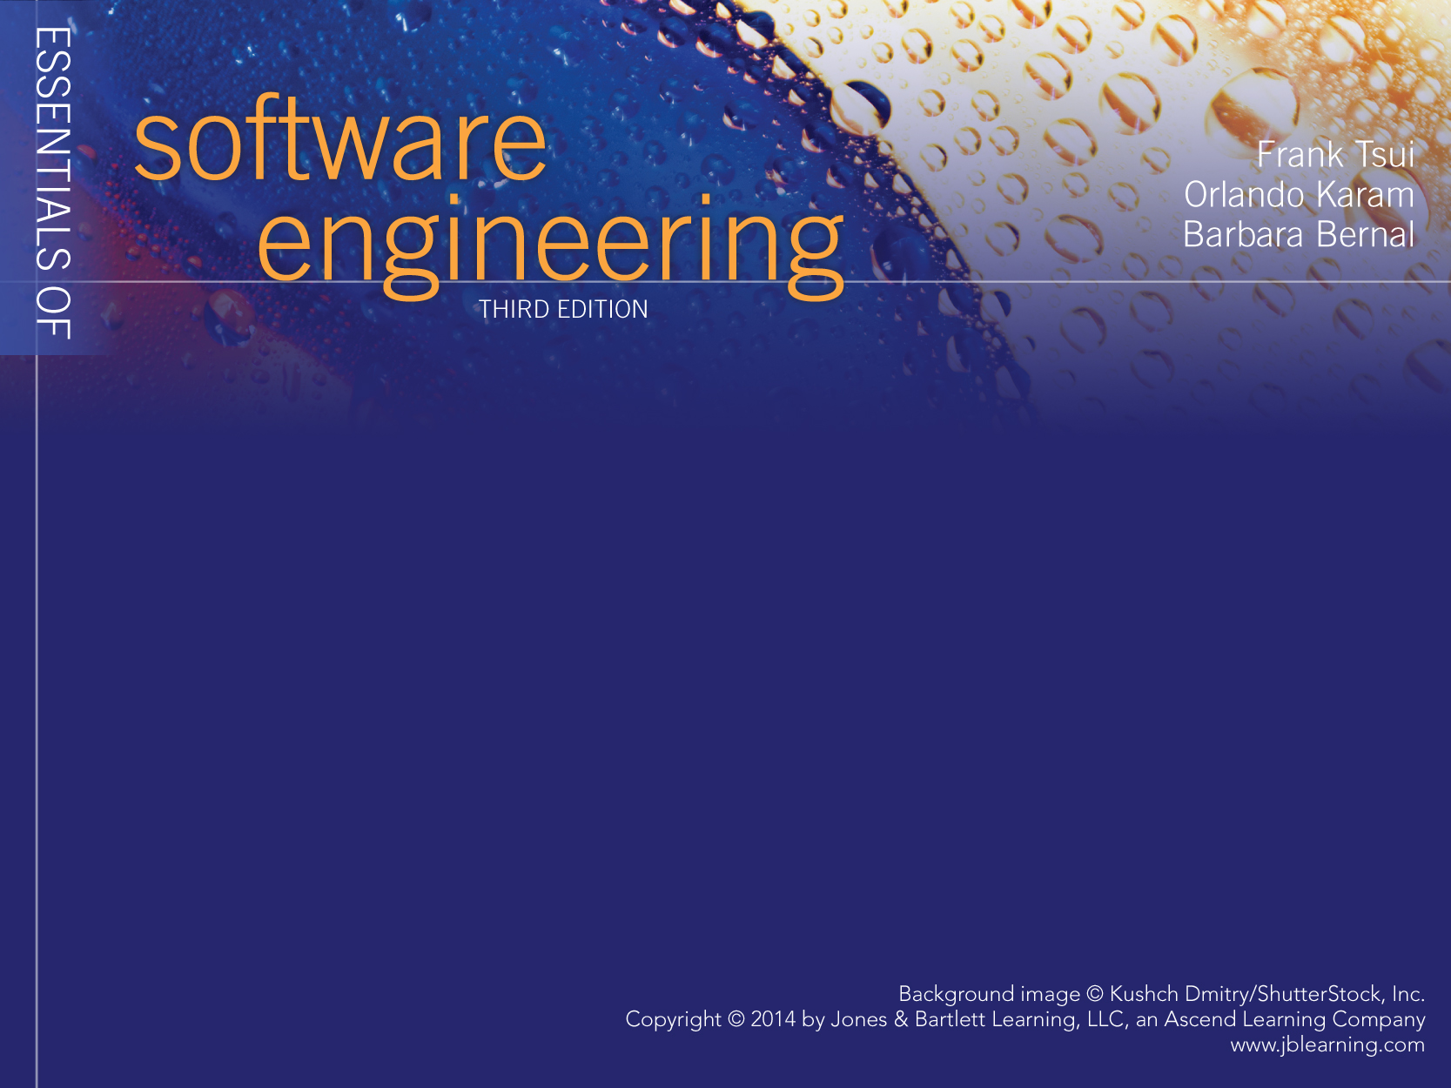
Chapter 1
Writing a Program

Slide 2
Introduction
We all “start” by learning how to code in some programming language.
  With a small, hypothetical, and fairly well defined problem
  Usually the code is within one module
We then learn that the program usually does not work on the first try, second try ------ may be even 5th or 6th try!
  We learn about “testing” the program
  We learn about re-reading and re-thinking the (problem) requirements more carefully --- then find that we may not have all the answers
  We learn about tracing and “debugging” the program
  Then ---- somehow magically ---- we decide that it’s “good enough !”
Perhaps
Not
In
This
Order

Slide 3
A “Simple” Set of Steps
1) Understand the problem – requirements
  Functionalities
  Non-functionalities: performance, security, modifiability, marketability, etc.
2) Perform Some Design --- based on requirements
  Organizing the functionalities in some sequence; possibly using some diagrams
  Focus on input/output ( data, formats, organization)
  Think about some constraints (non-functionalities) such as speed, UI looks, programming language, dependencies, etc.
  any specific algorithm and improvements on sequence of functionalities.

Slide 4
A “Simple” Set of Steps (cont.)
3) Code/Implement – Turning the design into actual code
  Depending on how much design is completed, one may either directly engage in conversion to code (language dependent) or do some more designing.
    A) Converting input/output to specific UI Interface or I/O format
    B) Sequencing the processing in the desired order
    C) Ensuring and converting the processing “algorithm” correctly to the target language construct.
    D) figure out how to use language library (properly)

Slide 5
A “Simple” Set of Steps (cont.)
4) Validate/Test the program – check the program results (via output) with some predetermined set of inputs.
  The pre-determined inputs are “test cases” and requires some thinking.
  If the results do not match what is expected then:
    “Debug”
    Fix
    Retest ---- revalidate
  Stop when all test cases produce the expected results.
Question ---- How many test cases should we develop & run ---?

Slide 6
What Really Happens ?
“Imagined” – Ideal Situation
Problem
Definition/
Understanding
Solution
Design
Solution
Implementation/
coding
Solution
Testing
“Actual” - Happening
Problem
Definition/
Understanding
Solution
Implementation/
Coding
Solution
Design
Solution
Testing

Slide 7
Code is “Done!” What Else Matters?
How Long (elapsed time) did it take to complete the work?
How much effort (total person hours) is expended to do the work?
Does the solution solve the complete problem?
How “good” is the work – (code, design, documentation, testing, etc.)?
based on ?

